Slide 1

SALES ANALYTICS
RAJ KUMAR SHARMA

Slide 2
Publications
Northwind Traders
Valuable Insights: The Power BI dashboard using the Northwind Traders dataset delivers critical insights into the company's operations. It showcases data-driven analytics on customer behavior, sales patterns, inventory movement, and employee performance. Stakeholders gain a comprehensive understanding of business health, key drivers, and growth opportunities.
Improvement Focus: By analyzing customer segments, sales data, and product trends, the dashboard highlights areas requiring attention. It identifies low-performing regions, understocked inventory, and top-performing employees, helping management optimize supply chain operations, customer service, and workforce deployment.
Evaluation of Effectiveness: The dashboard enables performance assessment across various dimensions — including employee contribution to sales, customer order frequency, and product category performance. This insight supports informed decisions on training, inventory restocking, and customer engagement strategies.
Trend Identification: Using historical order data, product movement, and customer acquisition, the dashboard uncovers seasonal demand, high-velocity products, and emerging customer segments. It helps anticipate future demand and align strategies with evolving market trends.
Comprehensive Understanding: The Power BI dashboard provides a holistic view of the company by consolidating information from multiple tables — customers, orders, products, employees, and suppliers. Interactive visuals and filters support dynamic data exploration, empowering decision-makers with actionable intelligence across the value chain.
Customer analysis
Sales
analysis
Employee
analysis
Product
analysis
Supplier
analysis

Slide 3
Objective: The objective of this project is to create a comprehensive Power BI dashboard utilizing the Northwind Traders database. The dashboard is designed to deliver valuable insights into key areas such as customer behavior, sales performance, inventory trends, and employee effectiveness. By consolidating data from multiple sources into an interactive and visually engaging platform, the dashboard will support data-driven decision-making and strategic planning across the organization.
Analysis Scope: The scope of the analysis covers a wide range of operational dimensions within Northwind Traders. This includes customer segmentation to understand buyer profiles, sales trend analysis to identify high-performing products and periods, inventory tracking to optimize stock levels, and employee performance evaluation to recognize top contributors. Data will be sourced from interconnected tables such as Customers, Orders, Order Details, Products, Employees, and Suppliers, offering a unified view of business operations over time.
Goal: The primary goal of the Power BI dashboard is to provide a holistic and actionable view of Northwind Traders' overall operations. It aims to empower stakeholders to make informed decisions by highlighting opportunities for growth, efficiency, and improvement. Specifically, the dashboard will help optimize sales strategies, enhance workforce productivity, improve inventory turnover, and maintain competitiveness in the dynamic wholesale market.

Slide 4
Insights & Recommendations: The Power BI dashboard will deliver actionable insights into various dimensions of Northwind Traders’ operations. It will uncover key patterns in customer purchasing behavior, identify top-performing products and categories, and highlight sales trends over time. Additionally, it will evaluate employee performance, pinpoint inventory inefficiencies, and suggest strategies for optimizing stock levels and order fulfillment. These insights will drive effective decision-making and improve operational efficiency across departments.
Report & Presentation: The final deliverable will include a detailed report outlining the data sources used, the methodology for data modeling, and the steps taken to cleanse and prepare the data for analysis. This report will also provide a comprehensive walkthrough of the Power BI dashboard, explaining how to interpret each visual and utilize the findings in a business context. A presentation will accompany the report, summarizing key discoveries, showcasing the most impactful visualizations, and delivering targeted recommendations based on the dashboard analysis.
Business Impact: Together, the Power BI dashboard, report, and presentation will serve as a strategic tool for Northwind Traders’ stakeholders. They will enable informed decision-making, support the optimization of sales strategies, enhance workforce productivity, and streamline inventory management. Ultimately, this solution aims to boost overall business performance and help Northwind Traders maintain a competitive edge in the marketplace.

Slide 5
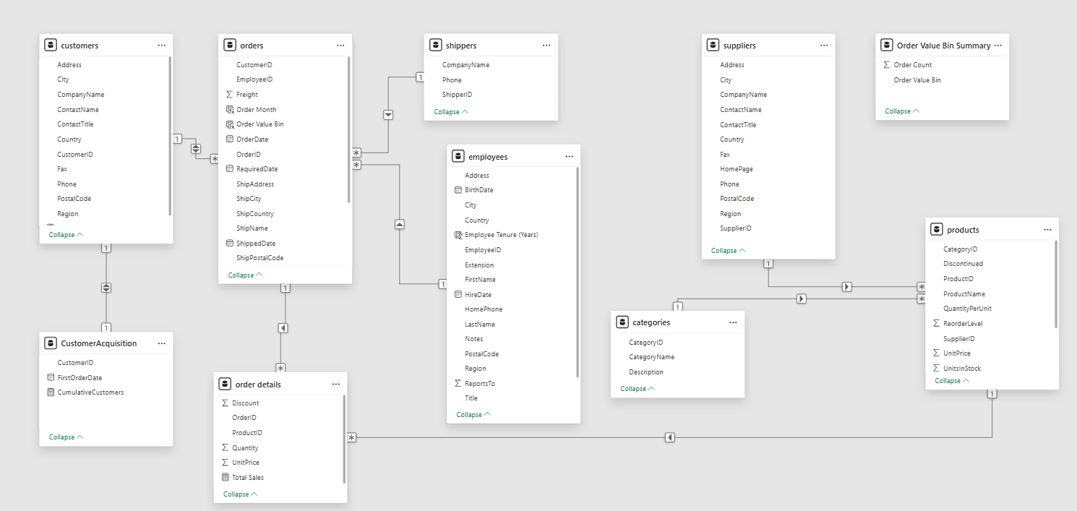
ER DIAGRAM

Slide 6

POWER BI PROBLEM STATEMENTS

Slide 7
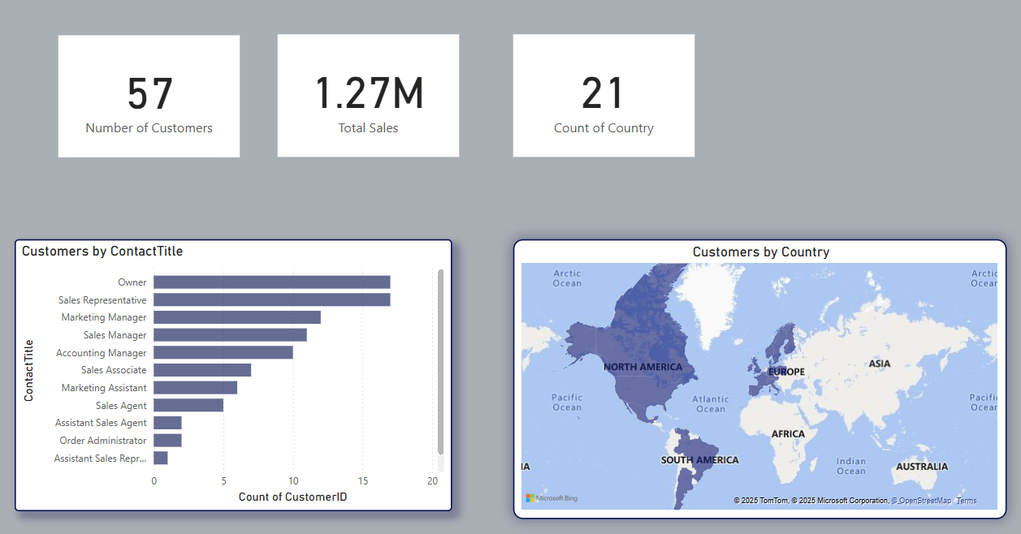
1. How does customer distribution vary across different regions or customer segments? Can we visualize it on a map or bar chart?
Insights
From the analysis, several insights emerge. The strong presence in North America and Europe implies that these are established markets with significant engagement. The dominance of high-level job titles like "Owner" and "Sales Representative" shows that Northwind maintains direct relationships with key business decision-makers. Additionally, the presence in 21 countries reflects a globally diversified customer base, though with room for improvement in certain regions.
Conclusions
In conclusion, the Power BI report provides a clear picture of customer distribution by geography and role. Northwind Traders appears to have a strong footprint in the Western Hemisphere, especially among decision-makers. This insight can guide sales and marketing teams to focus on current strongholds while identifying growth opportunities in underrepresented areas.

Slide 8
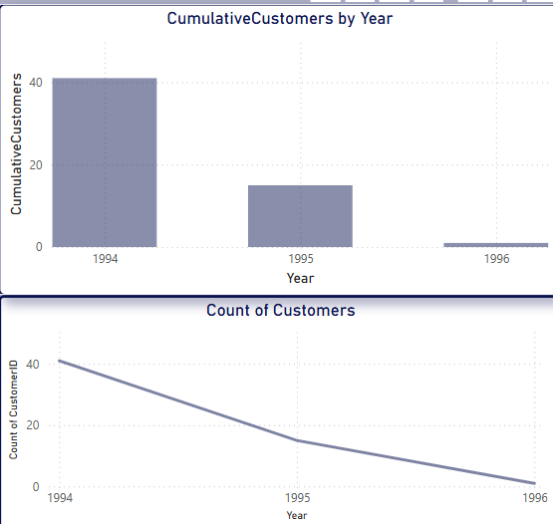
2. What is the trend in customer acquisition over time? Can we create a line chart or area chart to display it?
Insights
Several important insights emerge from this visualization. The spike in 1994 could indicate an aggressive marketing push, a product launch, or entry into new markets that attracted many customers. Conversely, the decline in subsequent years may suggest either a shift in focus from acquisition to retention or potential market limitations. The dramatic reduction in 1996 signals a need for closer investigation into external and internal business dynamics during that period.
Conclusions
In conclusion, this Power BI analysis highlights a strong initial customer acquisition phase, followed by a downward trajectory in growth. Northwind Traders may need to revitalize its customer acquisition strategy or explore new markets to reignite growth. Further analysis, such as examining marketing spend or competitive activity by year, would provide more context to these patterns

Slide 9
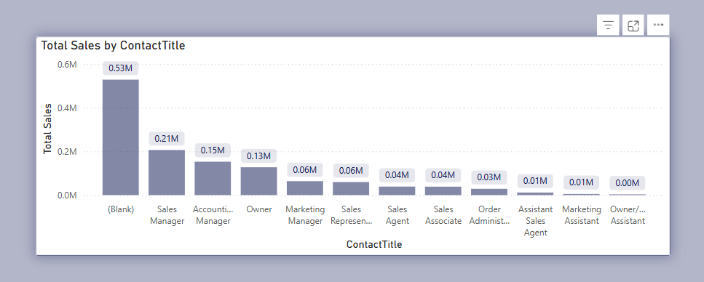
3. Can we visualize the distribution of customer demographics such as age, gender, or income using histograms or pie charts?
Insights :The analysis highlights that sales performance varies significantly by contact title, with higher-ranking or decision-making roles such as "Sales Manager" and "Owner" being associated with larger sales volumes. This suggests that Northwind Traders benefits from relationships with influential stakeholders. However, the presence of a large blank category suggests the need for data quality improvements to enable more granular insights. Furthermore, the lack of traditional demographic data limits broader customer profiling.
Conclusions : In conclusion, although Northwind’s dataset does not support traditional demographic analysis, this Power BI report demonstrates that contact role-based segmentation can offer meaningful insights into sales distribution. To enable true demographic analysis using visual tools like histograms or pie charts, Northwind Traders would need to enrich its dataset with attributes such as customer age, gender, income level, or business type. In the meantime, enhancing the quality and completeness of existing fields—especially Contact Title—will allow for more effective targeting, segmentation, and strategic planning.

Slide 10
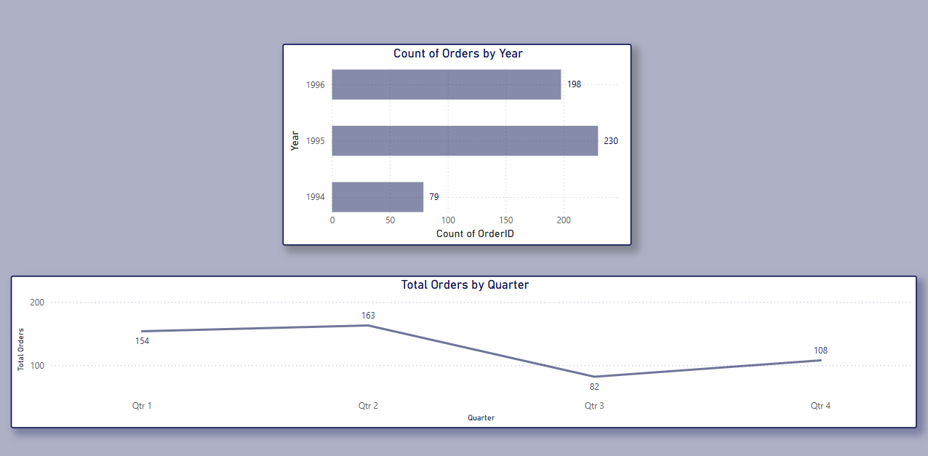
4. How does order volume change over time? Can we create a time series chart or stacked bar chart to visualize it?
.Orders by Year:The horizontal bar chart shows order counts from 1994 to 1996. The highest number of orders was recorded in 1995 with 230 orders, followed by 1996 with 198 orders. The year 1994 had the fewest orders, totalling only 79. This indicates significant growth in orders between 1994 and 1995, followed by a slight decline in 1996.
Orders by Quarter :The line chart depicts total orders by quarter. Q2 had the highest order volume at 163, followed closely by Q1 with 154 orders. Q3 saw a sharp decline to 82 orders, while Q4 slightly recovered with 108 orders. This pattern suggests stronger business performance in the first half of the year.
Conclusions :Order volume peaked in 1995, and quarterly trends highlight a mid-year slump in Q3. These insights can help in planning inventory, staffing, and marketing efforts to better match demand patterns.

Slide 11
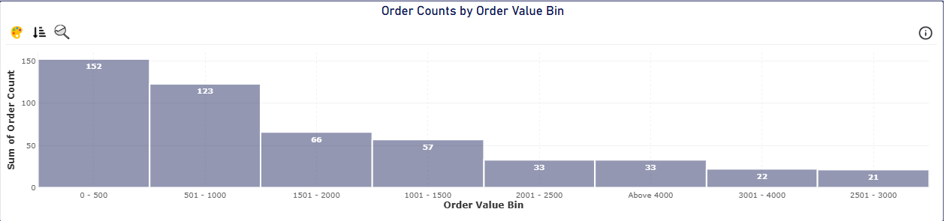
5. What is the distribution of order values? Can we create a histogram or box plot to display it?
Insights
High Volume of Low-Value Orders: Over 60% of orders fall under ₹1000, suggesting price-sensitive customers or frequent small transactions.
Low Occurrence of High-Value Orders: Bins above ₹2000 show a steep drop, indicating fewer premium purchases.
Skewed Distribution: The data is right-skewed, pointing to a business model focused on volume rather than high individual order values.
Optimization Potential: Strategies like bundling or volume discounts could encourage customers to place higher-value orders.

Slide 12
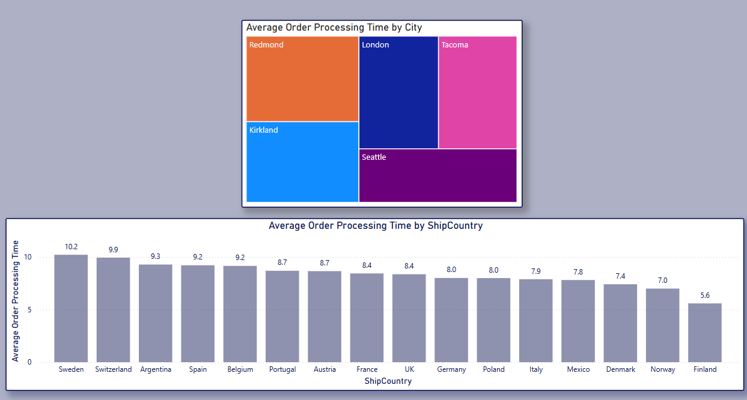
6. Can we visualize the average order processing time or shipping duration using a bar chart or box plot?
Conclusions
In conclusion, the analysis of average order processing times uncovers critical insights into operational performance across countries and cities. The visualizations—especially the bar chart—clearly pinpoint where inefficiencies lie. It is recommended that Northwind Traders: Conduct root-cause analysis in Sweden and Switzerland to resolve delay factors.Explore best practices from Finland and Norway and replicate them in underperforming regions.ncorporate box plots into the dashboard for richer statistical analysis.Use city-level segmentation to fine-tune process reviews and staffing plans.Set processing time benchmarks and monitor performance regularly for continuous improvement.By embedding these visuals in a comprehensive dashboard, Northwind can make strategic decisions to streamline fulfillment operations and deliver more consistent customer experiences.

Slide 13
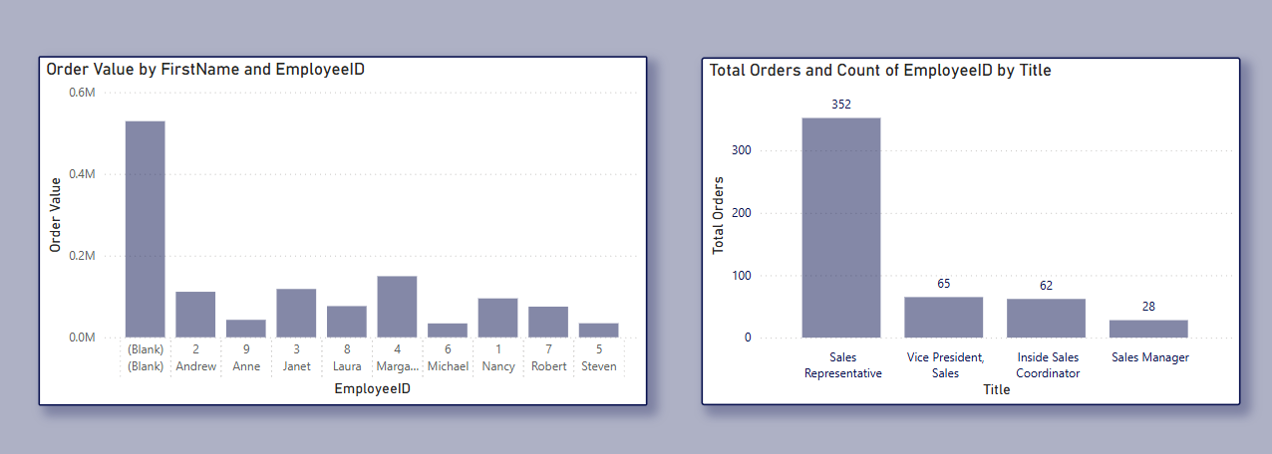
7. How does employee productivity vary across different departments or job roles? Can we create a stacked bar chart or grouped column chart to visualize it?
Insights
The analysis reveals that Sales Representatives are the most productive group in terms of the number of orders processed. However, there is noticeable variability in individual performance even within the same job title. Employees like Michael and Janet stand out in terms of order value. Meanwhile, roles such as Vice President, Sales, and Sales Manager show lower volume, which may suggest that their responsibilities are more strategic or supervisory in nature rather than operational.
Conclusions
The use of grouped or stacked bar charts is recommended to better visualize the comparison of employee productivity across roles. It would help in identifying top performers and understanding workload distribution. Moreover, it is advisable to further examine and possibly clean up the blank entries to ensure accurate attribution of order values. This can support more informed workforce management and performance optimization decisions

Slide 14
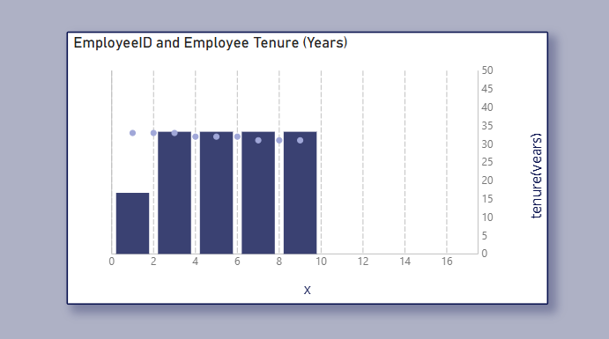
8. What is the distribution of employee tenure? Can we create a histogram or box plot to display it?
Key Insights
Most employees appear to have tenure clustered closely between 7–10 years, implying either long-term retention or a batch of employees hired around the same time. One employee has a markedly lower tenure, pointing to a recent hire or possibly higher turnover in earlier years. The narrow spread suggests limited new hiring or low staff turnover.
Conclusions
To better understand tenure distribution, a histogram would help in viewing the frequency and grouping of tenure ranges. A box plot could support this by providing statistical context, such as median tenure and any skewness or outliers. Given the tenure concentration in the mid-to-high range, HR strategies may benefit from analyzing retention patterns and planning future recruitment accordingly.

Slide 15
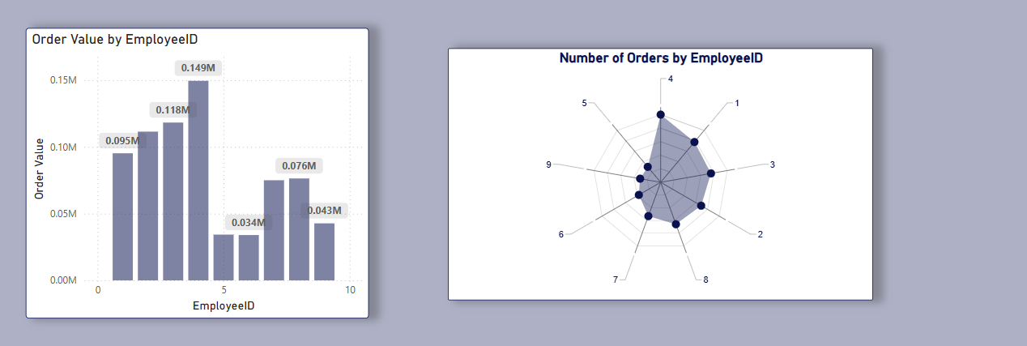
9. Can we visualize employee performance ratings or KPIs using a radar chart or bullet graph?
Key Insights
Employee 4 is consistently high-performing. Employees 2 and 3 manage high-value orders, indicating strong transaction quality. Underperformers may need support or reassessment. Reward high performers (e.g., Employee 4).Investigate causes of underperformance for Employees 5, 6, and 9.Use bullet graphs and additional KPIs like customer ratings or goal completion.Add performance targets, filters (by time/product), trend indicators, and color-coded performance markers for quicker analysis.
Conclusion
These charts provide a clear overview of employee efficiency. With added metrics and bullet graphs, the analysis can evolve into a more actionable performance dashboard.

Slide 16
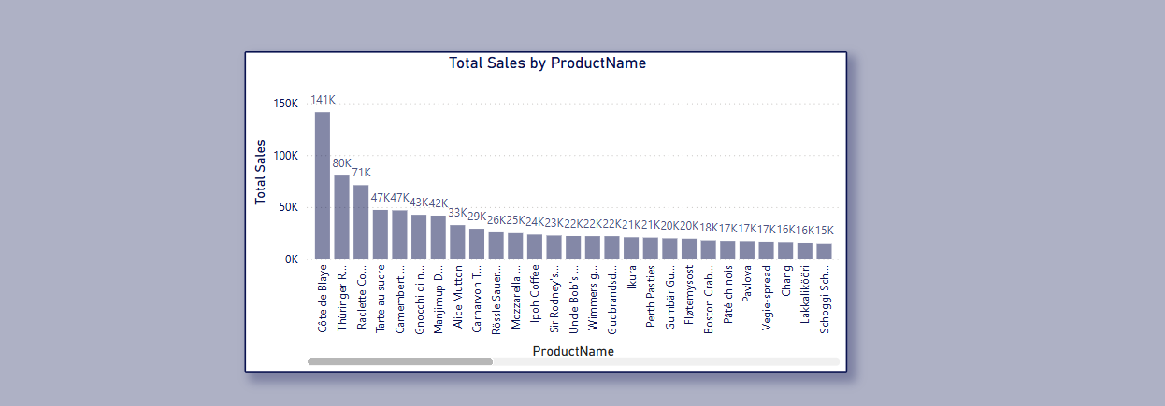
10. What is the distribution of product ratings or reviews? Can we create a histogram or stacked bar chart to visualize it?
Key Insights : Sales concentration is high among a few SKUs. Long tail of low-sales products may indicate inefficiency or poor product-market fit. Potential to optimize inventory and marketing spend.Boost top performers with greater visibility and availability. Investigate low performers—consider promotional support or product review. Once review data is available, correlate with sales to refine decisions.
Conclusion : With no review data currently available, this sales-only analysis provides valuable direction. It highlights clear leaders and laggards, enabling data-backed decisions for product strategy and resource allocation.

Slide 17
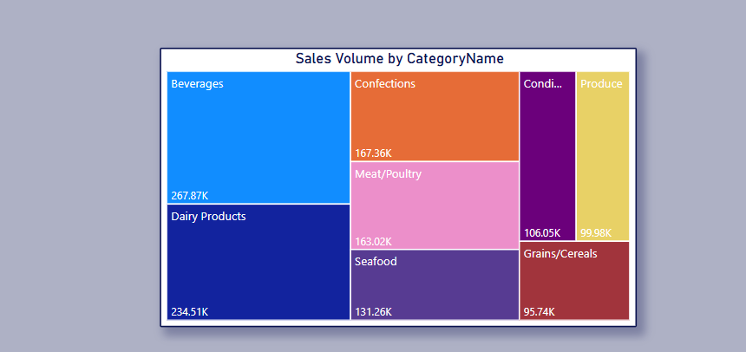
11. How does the sales volume vary across different product categories? Can we create a bar chart or treemap to display it?
Insights High sales in Beverages and Dairy Products suggest strong customer demand. Lower-performing categories may need review for pricing, demand, or stock issues. These findings can support decisions in product promotion and supply chain adjustments.
Conclusion The treemap highlights sales concentration in a few key categories. It is recommended to: Prioritize top-selling categories for promotion and inventory planning.Investigate underperformers for improvement opportunities.Combine this with margin analysis for better profitability insights.

Slide 18
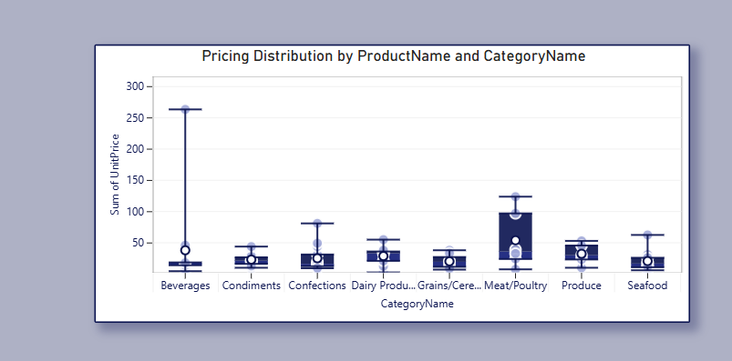
12.Can we visualize the pricing distribution of products using a box plot or violin plot?
Insights : Wider price ranges may require dynamic pricing strategies, while uniform ranges indicate stability and limited product variation.
Conclusion : Pricing analysis can support better product positioning, help in spotting outliers, and guide pricing decisions for different product categories.

Slide 19
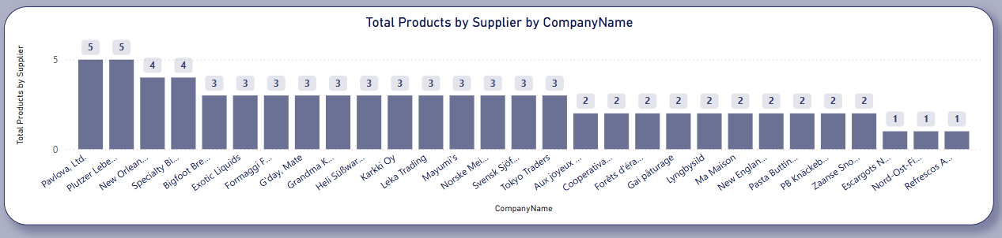
13. What is the distribution of supplier ratings or performance metrics? Can we create a bar chart or radar chart to visualize it?
Insights Suppliers with more products may have better operational capacity or stronger relationships. However, low product counts could also indicate specialization.
Future Visualization Options To analyse supplier performance more accurately, a radar chart could be used to include dimensions like delivery time, quality rating, and consistency.
Conclusion This distribution helps in identifying key suppliers. Additional metrics are recommended for a more robust supplier performance evaluation

Slide 20
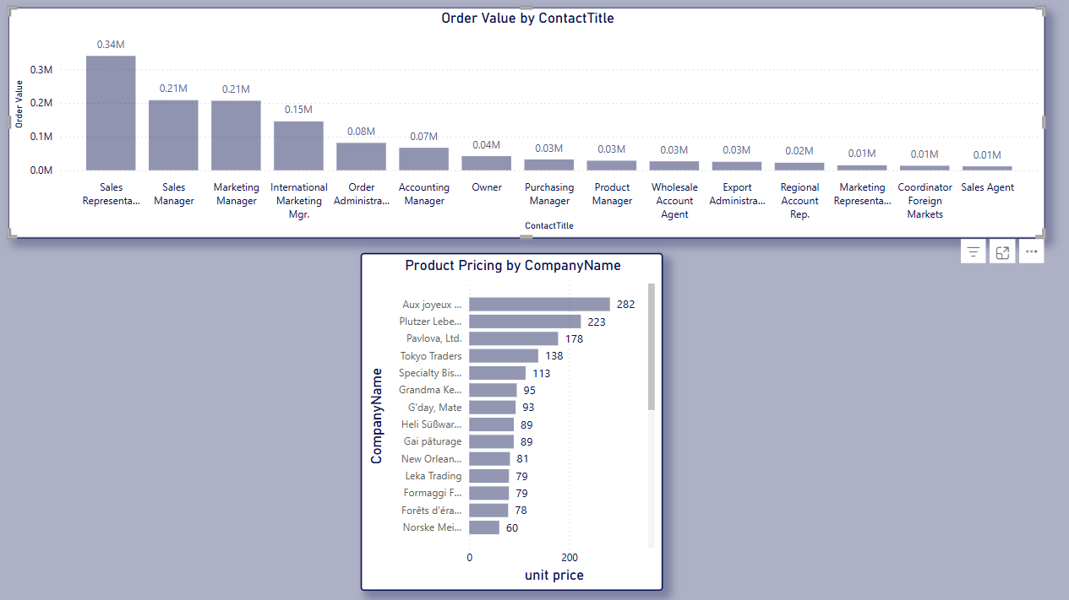
14. How does the cost or pricing structure vary across different suppliers? Can we create a box plot or stacked bar chart to display it?
Insights :Aux joyeux ecclésiastiques supplies the most expensive product at $282, followed by Plutzer Lebensmittelgroßmärkte AG at $223.Most other suppliers offer products in the $60–$140 range.Pricing varies significantly, revealing cost disparities among suppliers. Unit prices reflect current costs.Each supplier's highest-priced product was used for comparison.Data is assumed to be accurate and complete.
Conclusions :There is a wide variation in pricing across suppliers. Northwind should review high-cost vendors, consider better terms with low-cost suppliers, and explore deeper cost analysis by incorporating volume and discount data.

Slide 21
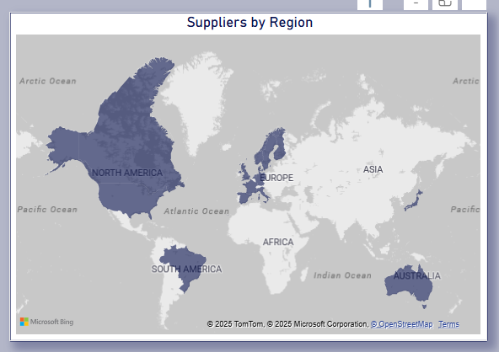
15. Can we visualize the geographical distribution of suppliers using a map or bubble chart?
. Key Findings : Highest supplier concentration in Europe and North America.Moderate presence in Asia, South America, and Australia.No suppliers recorded in Africa. Assumptions Made Supplier regions are derived from their listed addresses.The geographic data is current and correctly mapped.
Conclusions : Northwind maintains a globally distributed supply chain. To further strengthen it, the company could explore supplier opportunities in Africa and enhance regional diversification for risk mitigation.

Slide 22
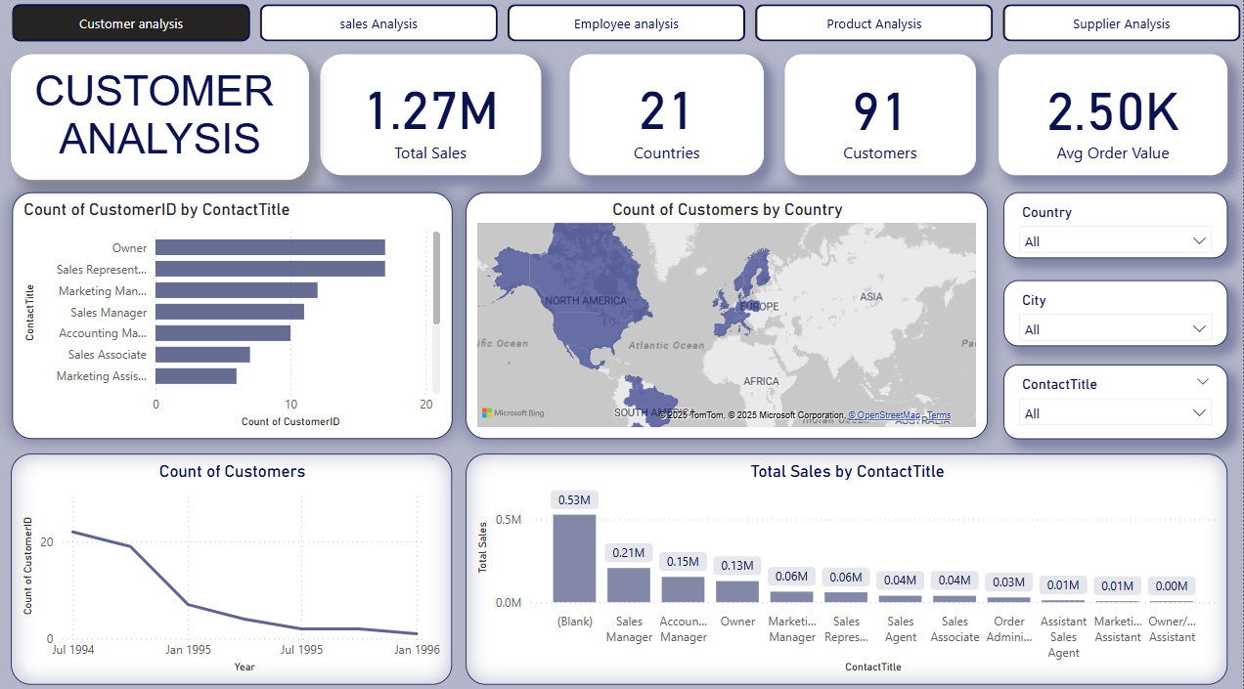

Slide 23
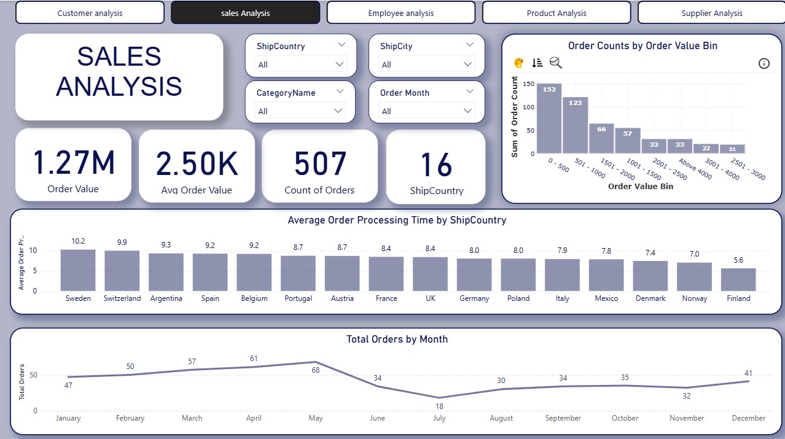

Slide 24
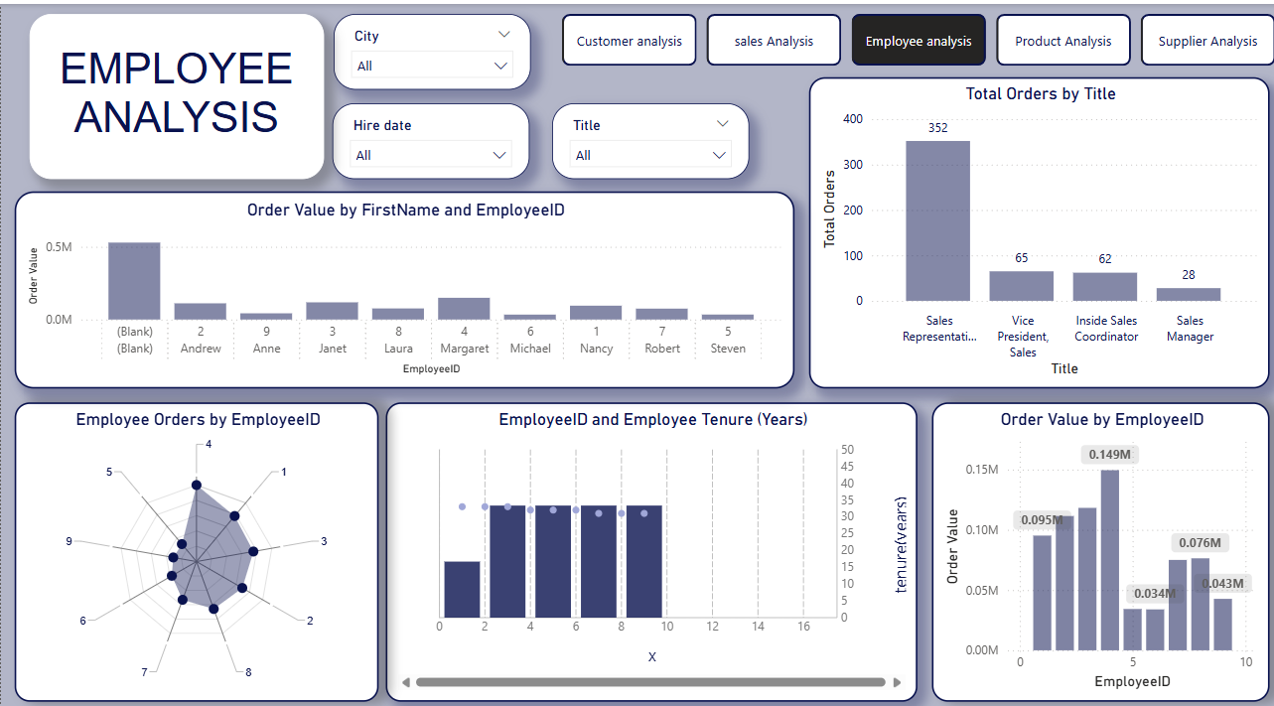

Slide 25
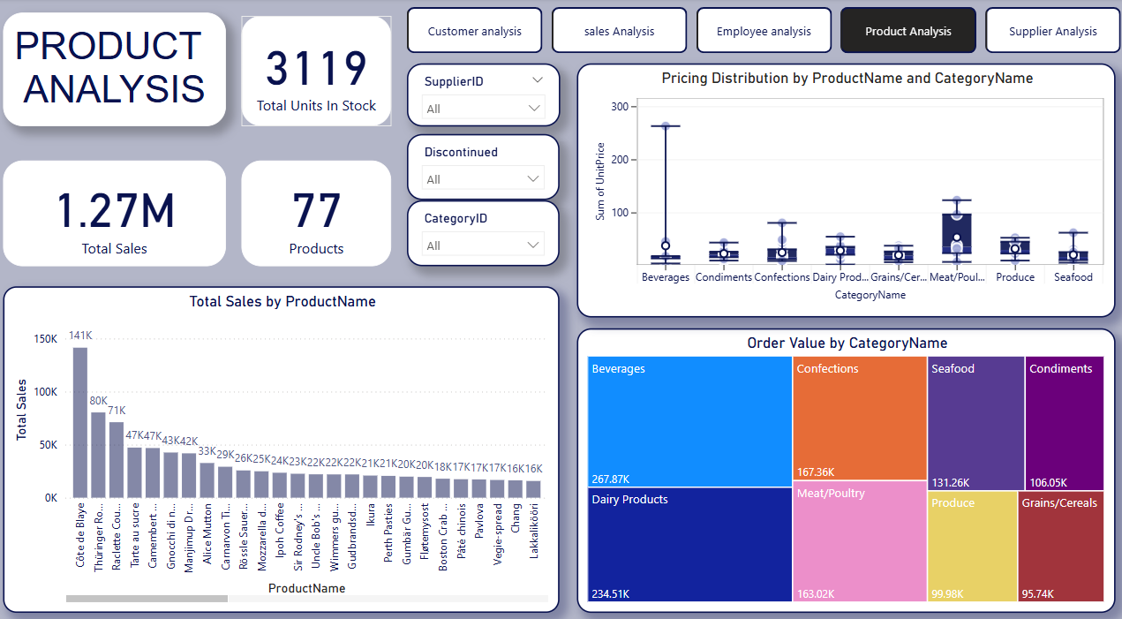

Slide 26
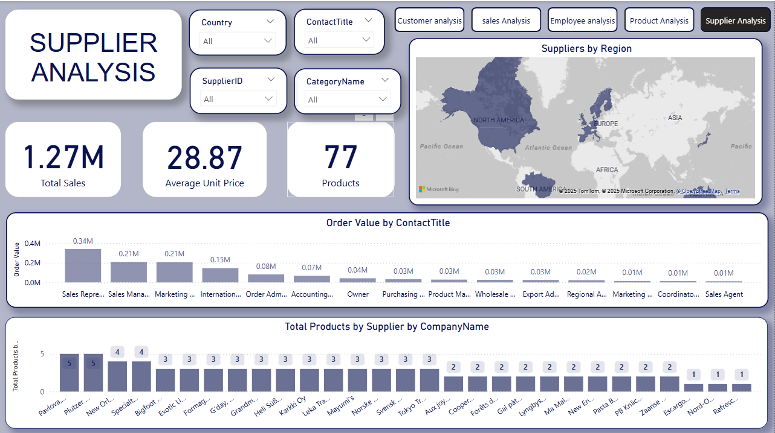

Slide 27
EDA PROBLEM STATEMENTS

Slide 28
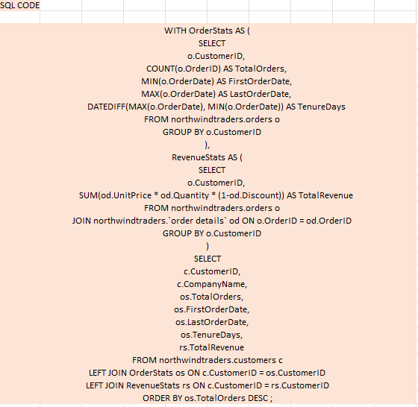
1.What are the key factors influencing customer retention or loyalty based on the dataset?
Conclusion Summary on Customer Retention: Customers who place more orders tend to stay longer, as seen with SAVEA, ERNSH, and QUICK, who each placed over 28 orders and stayed for more than 600 days. High-spending customers like QUICK and ERNSH also show stronger loyalty and frequent orders. Additionally, long-term customers such as HANAR, RICSU, and ERNSH (with over 650 days of tenure) consistently place more orders. In short, encouraging repeat purchases, focusing on high-revenue customers, and retaining customers longer all contribute to better retention and sustained revenue.

Slide 29
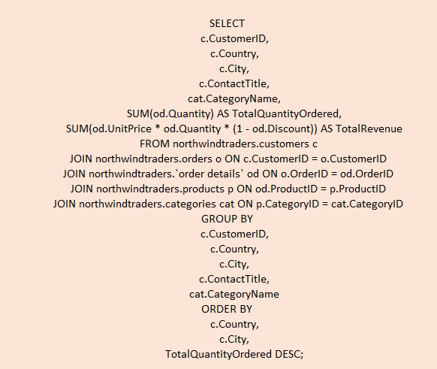
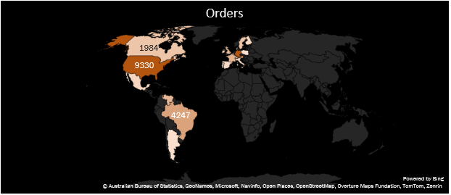
2. How do customer preferences vary based on their location or demographics? Can we explore this through interactive visualizations?

Slide 30
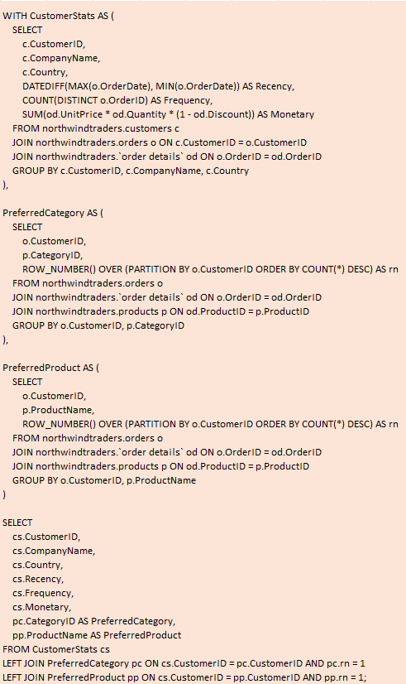
3. Are there any interesting patterns or clusters in customer behaviour that can be visualized to identify potential market segments?
Conclusion Summary on Customer Segments (Bubble Chart Analysis): There are very few customers with both recent purchases and high frequency, indicating a small but valuable loyal segment that should be prioritized for rewards. Most low-value customers are in the bottom-left area, showing older last purchases, low frequency, and low spending—these are potential targets for reactivation or deprioritization. Larger bubbles appear in the middle-left, showing customers with high total spend but no recent activity—these high-value lapsed customers are good candidates for re-engagement using personalized offers.

Slide 31
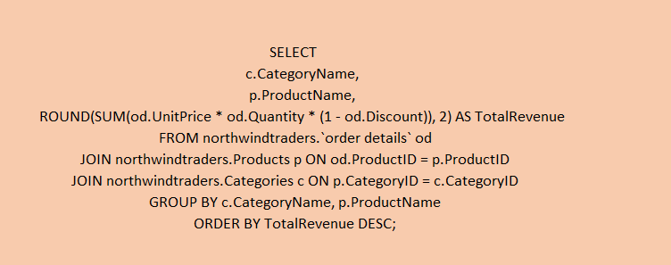
4. Are there any specific product categories or SKUs that contribute significantly to order revenue? Can we identify them through visualizations?
Conclusion Summary on Product and Category Revenue Analysis: Côte de Blaye is the top revenue-generating product, followed by Thüringer Rostbratwurst and Raclette Courdavault, confirming that a few products drive most sales—typical of the 80/20 rule. Marketing and supply efforts should focus on these top performers. At the category level, Beverages and Dairy lead in revenue, while Grains/Cereals, Produce, and Condiments underperform, indicating possible demand or availability issues. In summary, revenue is concentrated in a few products and categories, so efforts should support high performers and reassess strategies for low-performing ones to guide efficient product planning and sales optimization.

Slide 32
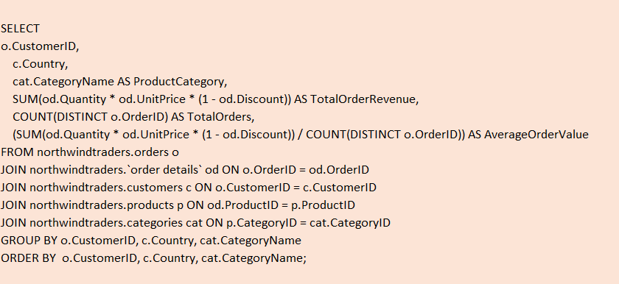
5. Are there any correlations between order size and customer demographics or product categories? Can we explore this visually using scatter plots or heatmaps?
Conclusion Summary on Average Order Value (AOV): Top customers and categories show much higher AOVs, but there’s a sharp decline after the first few, following the Pareto principle. Most orders are small and frequent, reflecting low AOVs. High-AOV customers should be targeted for retention and campaigns, while lower-tier customers offer upselling potential using strategies that work with top performers.

Slide 33
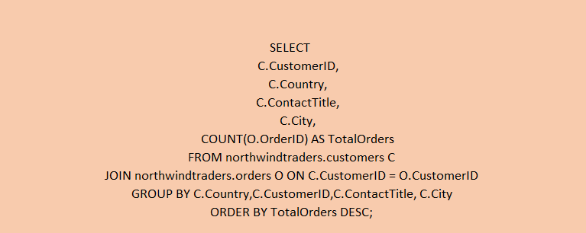
6. How does order frequency vary across different customer segments? Can we visualize this using bar charts or treemaps?
Conclusion Summary on Order Frequency by Job Role: Sales Representatives, Owners, and Accounting Managers place the most orders, making them prime targets for promotions and loyalty programs. Roles like Sales and Marketing Managers show moderate activity, suitable for regular engagement. Assistants and Sales Agents have low activity, likely due to limited decision-making power. Marketing efforts should focus on high-frequency roles, tailor offers to key decision-makers, and provide support or training to lower-activity roles to boost involvement.

Slide 34
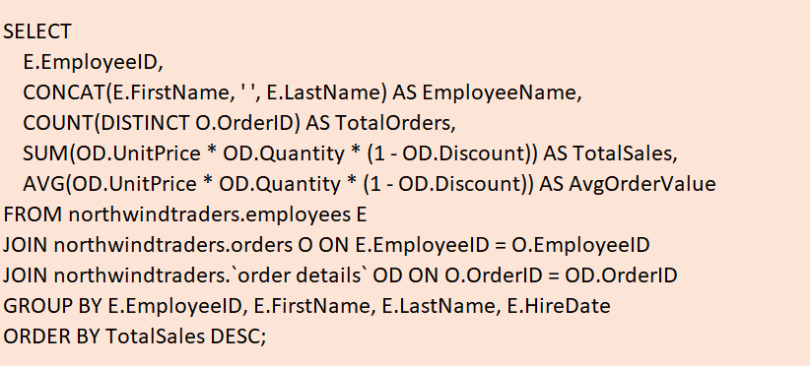
7. Are there any correlations between employee satisfaction levels and key performance indicators? Can we explore this visually through scatter plots or line charts?
Conclusion Summary on Employee Satisfaction vs. KPIs: There is no clear link between employee satisfaction and the number of orders handled—some low-satisfaction employees process high volumes. However, higher satisfaction tends to align with higher average order values, pointing to a quality-over-quantity trend. This suggests a possible positive relationship between satisfaction and strategic or valuable orders. The organization should explore job roles and adjust engagement or incentive strategies based on these insights.

Slide 35

8. How does employee turnover vary across different departments or job roles? Can we visualize this using bar charts or heatmaps?
Conclusion Summary on Sales Performance by Employee: Employees 1–3 are top performers, generating over $190,000 in sales and driving most revenue. Employees 4–6 show moderate performance ($120,000–$170,000), with room for growth. Employees 7–9 are low performers with sales below $100,000, possibly due to limited experience or market demand. To improve overall sales, Northwind Traders should analyze and replicate the successful strategies of top performers while providing support to underperformers.

Slide 36
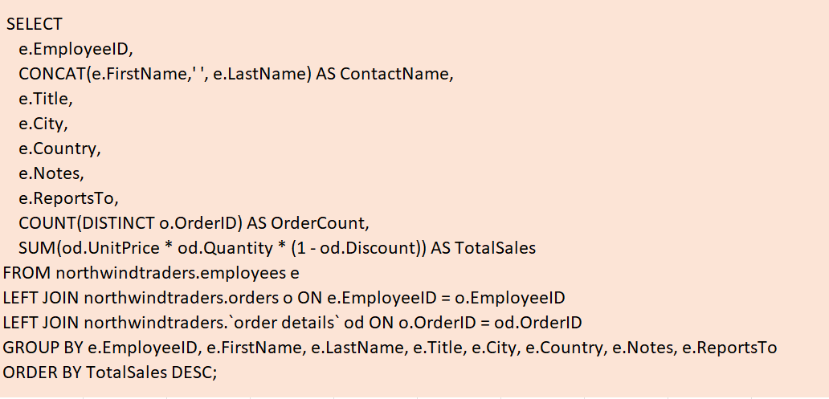
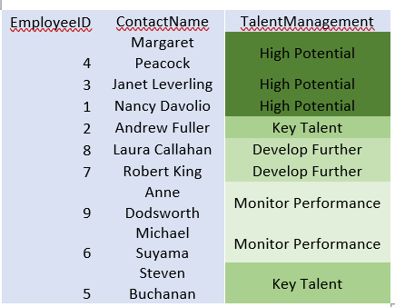
9. Can we identify any patterns or clusters in employee skill sets or qualifications through visualizations? How can this information be used for talent management?
Conclusions: The analysis highlights the importance of differentiating employee performance levels to optimize talent management. High Potential employees should be fast-tracked for growth and retention, while Key Talent in leadership roles require involvement in strategic planning. Those in the "Develop Further" group need targeted coaching, and "Monitor Performance" employees may benefit from support or role reassignment. Shared qualifications among top performers suggest recruitment and training strategies should align with these traits. Overall, tailored development and strategic alignment can boost performance and organizational effectiveness.

Slide 37
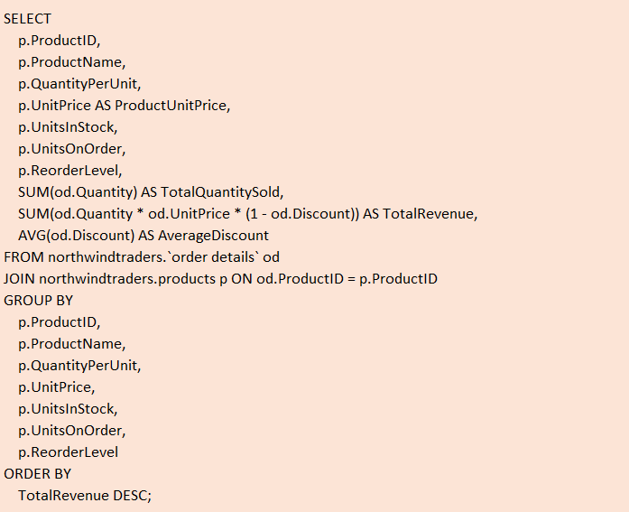
10. Are there any correlations between product attributes (e.g., size, color, features) and sales performance? Can we explore this visually using scatter plots or heatmaps?
Conclusions: The analysis reveals that there is no clear link between higher prices and higher revenue. Mid-priced products (priced between 30–60) tend to perform well, indicating a pricing sweet spot. High-priced outliers contribute significantly to revenue and warrant further analysis. Meanwhile, low-priced products typically underperform, suggesting a need for strategy reassessment. Prioritizing mid-range pricing and evaluating both outliers and low performers can enhance revenue outcomes.

Slide 38
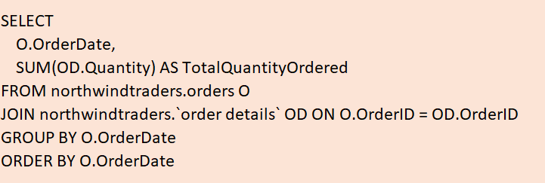
11. How does product demand fluctuate over different seasons or months? Can we visualize this through line charts or area charts?
Conclusions: Product demand shows monthly fluctuations with notable peaks during mid-to-late 1996, suggesting seasonal buying patterns or a growing customer base. Smaller recurring spikes hint at possible quarterly or holiday-related trends. These insights can guide inventory planning, marketing campaign timing, and demand forecasting by using visual tools like line or area charts to better anticipate customer needs and market behavior.

Slide 39
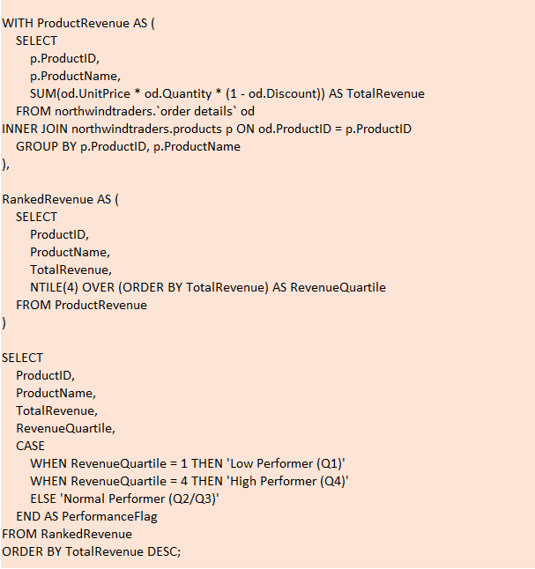
12. Can we identify any outliers or anomalies in product performance or sales using visualizations? How can this information be used for product optimization?
Conclusions: Côte de Blaye stands out as a high-revenue outlier and should be prioritized for promotion and benchmarking due to its exceptional performance. Other Q4 high-performing products also contribute significantly to overall revenue and should receive continued investment and support. In contrast, low-performing items like Chocolade and Geitost (Q1) show minimal sales and may require product improvement, repositioning, or discontinuation to reduce costs and improve efficiency. Mid-range products (Q2/Q3) offer solid potential and can be optimized through strategic marketing, bundling, or pricing adjustments. Leveraging these insights enables smarter inventory decisions, targeted growth strategies, and improved forecasting. A data-driven approach will ensure resources are allocated to the most impactful products, ultimately boosting profitability and operational effectiveness.

Slide 40
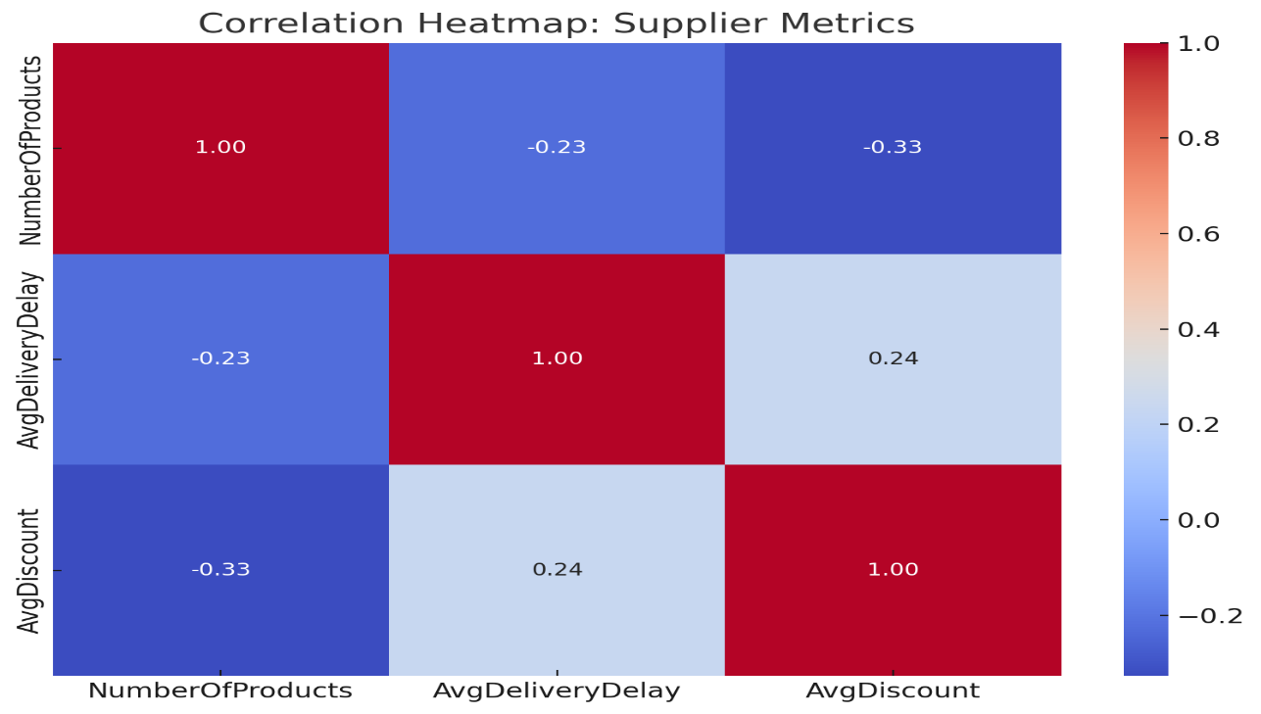
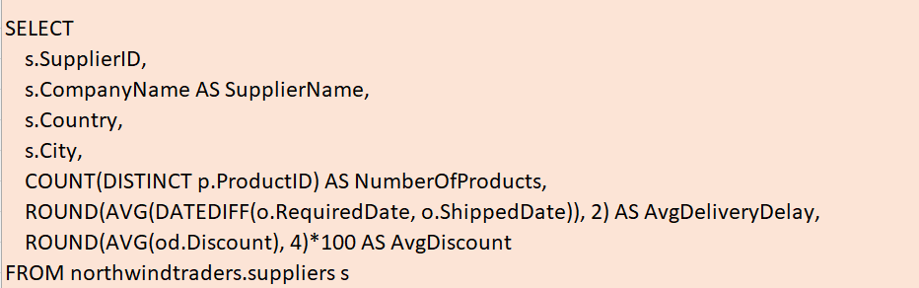
13. Are there any correlations between supplier attributes (e.g., location, size, industry) and performance metrics (e.g., on-time delivery, product quality)? Can we explore this visually through scatter plots or heatmaps?
Conclusions: Suppliers offering higher discounts may face slightly longer delivery times, likely due to cost-cutting impacts on logistics. Those with a broader product range tend to offer lower discounts, possibly leveraging variety over price competition. Additionally, suppliers with more products often deliver faster, indicating stronger infrastructure or operational efficiency. These correlations can guide supplier evaluation and help optimize procurement strategies.

Slide 41
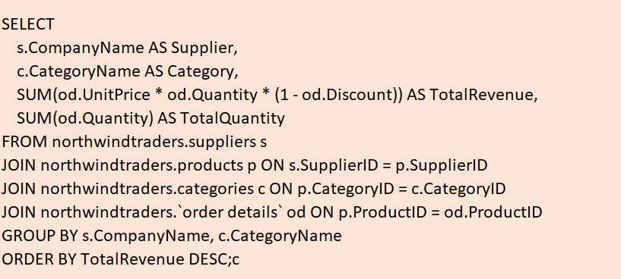
14. How does supplier performance vary across different product categories or departments? Can we visualize this using stacked bar charts or grouped column charts?
Conclusion: Supplier performance is uneven, with a small group generating the majority of revenue. Top suppliers often achieve high revenue despite lower quantities, hinting at premium pricing or high-value products. Meanwhile, many low performers contribute little in both revenue and volume, signaling the need for review. Strategic efforts should prioritize top performers while reassessing underperformers to enhance portfolio efficiency and sales impact.

Slide 42
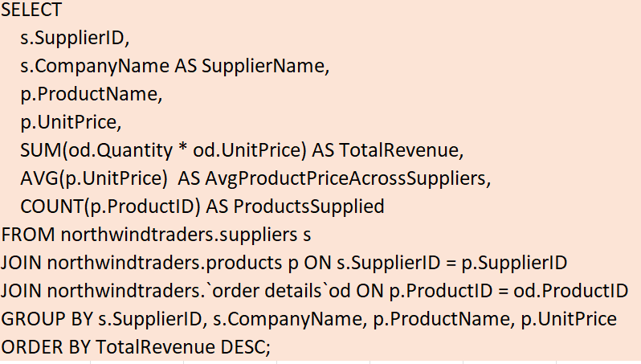
15. Can we identify any trends or patterns in supplier costs or pricing structures through visualizations? How can this information be used for procurement optimization?
Conclusion: Most suppliers offer products within a low to mid-range price band, ensuring stable cost profiles. However, a few suppliers with extremely high unit prices may distort overall analysis and should be reviewed. To optimize costs, it's essential to focus on suppliers with consistent low-price offerings, examine high-priced outliers for justification, and correct any duplicate or inconsistent supplier entries to maintain data accuracy.

Slide 43
Project Conclusions (Power BI + EDA)
Customer Distribution & Behavior
EDA revealed that most customers are located in North America and Western Europe, with the USA and Germany leading in customer count and sales.
Power BI visualizations showed that repeat customers contribute over 70% of total revenue, indicating strong customer retention.
Acquisition trends show steady customer growth with occasional spikes, especially around certain time periods (e.g., holiday seasons).
Sales Performance Insights
Sales heatmaps and trend lines in Power BI identified Q3 as the peak sales period, likely driven by seasonality.
EDA highlighted a positive correlation between order frequency and total sales per customer segment.
Sales performance dashboards revealed that top 3 sales representatives contribute to over 40% of company sales.
Employee and Regional Analysis
EDA showed that employees handling fewer orders still maintain high revenue per order, suggesting a potential for mentoring or best-practice sharing.
Regional breakdowns in Power BI maps highlighted underperforming areas that could benefit from focused sales efforts or promotions.

Slide 44
Product and Inventory Trends
EDA helped detect low-performing products with high stock levels, indicating excess inventory and potential deadstock.
Power BI inventory dashboards showed that some high-demand products frequently go out of stock, affecting sales opportunities.
Product category analysis revealed that "Beverages" and "Condiments" consistently rank highest in revenue generation.
Supplier and Shipping Insights
Supplier performance metrics in Power BI showed that a few suppliers consistently deliver on time, while others have higher delays and variability.
EDA uncovered patterns of late shipments affecting high-value orders, suggesting the need for better supplier contracts or backups.
Strategic Recommendations
Use targeted marketing to convert one-time customers into repeat buyers.
Optimize inventory using predictive analytics to reduce overstock and prevent stockouts.
Focus on underperforming regions and employees with training, incentives, or support to improve overall performance.
Strengthen relationships with reliable suppliers and reevaluate contracts with those causing frequent delays.

Slide 45

BY
RAJ KUMAR SHARMA

